Slide 1


Microbiome Data Analysis Workshop
Audrey Renson, Lucas Schiffer, Levi Waldron
December 15, 2017
@leviwaldron1
www.github.com/waldronlab
Notes:
Hi. I’d like to introduce you to MultiAssayExperiment, a framework for the representation and analysis of multi-omics experiments in Bioconductor.

Slide 2
Qualifications
Assistant Professor of Biostatistics, CUNY GSPHHP and ISPH
Bioconductor Technical Advisory Board
Post-docs with:
Igor Jurisica at U Toronto
Giovanni Parmigiani at Dana Farber Cancer Institute
Curtis Huttenhower at Harvard School of Public Health
Research areas:
Data structures for multi-omics analysis:
MultiAssayExperiment
Data resources for cancer genomics and microbiome studies:
curatedMetagenomicData, curatedTCGAData, HMP16SData, curatedOvarianData, curatedCRCData, curatedBladderData
The microbiome in population health
New York City Health and Nutrition Examination Study (NHANES)

Slide 3
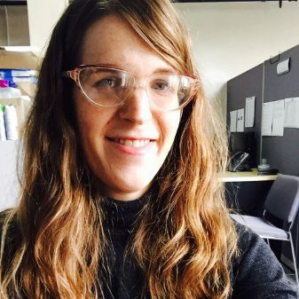

Qualifications
MPH candidate, CUNY GSPPH
Full-time data analyst, NYU School of Medicine
Part-time research assistant in my lab
Master’s fieldwork and thesis advisee
First author for NYC-HANES oral microbiome study¹
Key analyst for curatedMetagenomicData paper²
Audrey Renson
MPH alumnus, CUNY GSPPH
Full-time research associate in my lab
Master’s fieldwork and thesis advisee
Co-first author for curatedMetagenomicData²
Contributor to MultiAssayExperiment³, others
Lucas Schiffer
1. Renson, A. et al. Sociodemographic patterning in the oral microbiome. bioRxiv 189225 (2017). doi:10.1101/189225 2. Pasolli, E. et al. Accessible, curated metagenomic data through ExperimentHub. Nat. Methods 14, 1023–1024 (2017). 3. Ramos, M. et al. Software for the Integration of Multiomics Experiments in Bioconductor. Cancer Res. 77, e39–e42 (2017).

Slide 4
Topics for tonight
Sociodemographic Variation in the Oral Microbiome (Audrey Renson)
Using curatedMetagenomicData for Meta-analysis of Health Outcomes (Lucas Schiffer)
Workshop on curatedMetagenomicData and Bioconductor resources for microbiome data analysis

Slide 5
Microbial metagenomic analysis
16S rRNA
sequencing
Whole-metagenome shotgun
sequencing
Pros
cheap (multiplex hundreds of samples)
relatively small data
provides genus-level taxonomy and inferred metabolic function for bacteria and archaea
Cons
taxonomy reliable only to genus level
indirect inference of metabolic function
use of a single marker gene is susceptible to biases
Pros
taxonomy to species and even strain
viruses and fungi
gene variants, e.g. ABX resistance
use of many marker genes is less susceptible to biases
more direct + precise functional inference
Cons
expensive – probably no multiplexing
contamination from human DNA
big data (before processing)
5

Slide 6
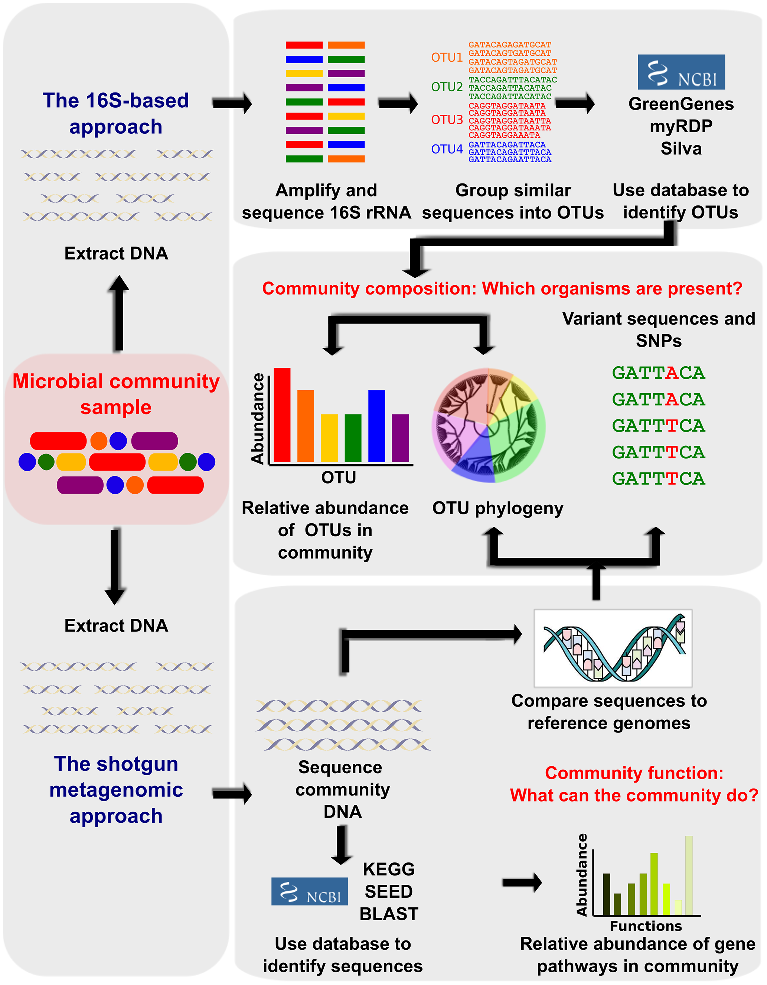
Microbial metagenomic analysis
Morgan and Huttenhower, Human Microbiome Analysis, PLoS Comp Bio
10.1371/journal.pcbi.1002808
6

Slide 7
Microbiome data analysis challenges
Sequence analysis (not covered tonight)
WMS data tend to be large
16S data tend to be highly multiplexed
(slightly) high-dimensional data
100s of features
Compositional data
Dominant species/genera can reduce the relative abundance of everything else
Taxonomic data
Often analyze multiple levels of the tree of life

Slide 8
Microbiome data analysis challenges
Differential abundance analysis
Y=microbial counts, x=exposures and confounders
May be highly over-dispersed, zero-inflated
Visualization
Principal Coordinates Analysis, heatmaps, …
Ecological analysis
Alpha diversity / richness (within-sample)
Beta diversity (between-sample)

Slide 9
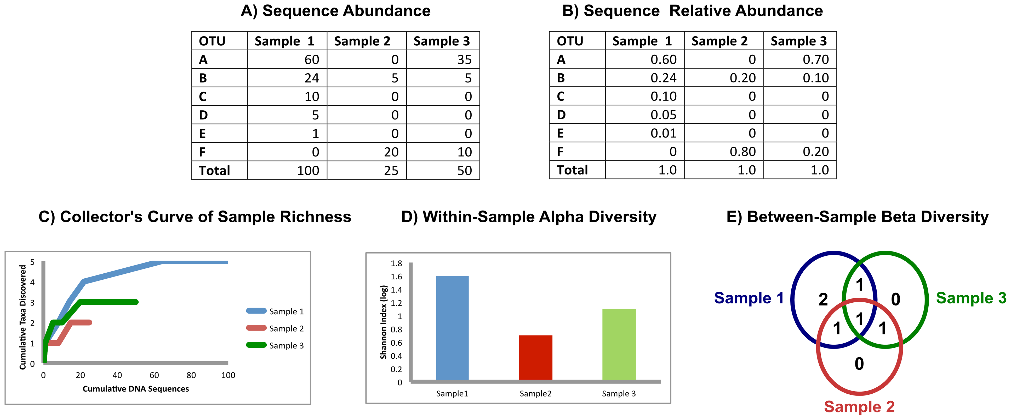
Alpha and Beta Diversity
Morgan and Huttenhower, Human Microbiome Analysis, PLoS Comp Bio
10.1371/journal.pcbi.1002808

Slide 10
Summary of R/Bioconductor tools
phyloseq
taxonomy-aware data management & plotting
alpha & beta diversity
Links to QIIME, packages for differential abundance
metagenomeSeq
Zero-inflated negative binomial models
Links to metavizr metagenome browser
DESeq2, edgeR
MultiAssayExperiment
Integrative data management for multi-omics experiments
HMP16SData
Data from The Human Microbiome Project
curatedMetagenomicData
Lots of metagenomic data
Links to phyloseq and metagenomeSeq

Slide 11
Motivation for curatedMetagenomicData
Increasing amount of public data
Can be fast and free, but hard to use:
Fastq files from NCBI, EBI, …
Bioinformatic expertise
Computational resources
Manual curation / standardization
Wanted to make acquisition of curated, ready-to-use public data easy and reproducible
Pasolli/Schiffer/Manghi et al. Accessible, Curated Metagenomic Data Through ExperimentHub.
Nature Methods 2017, 14(11).

Slide 12


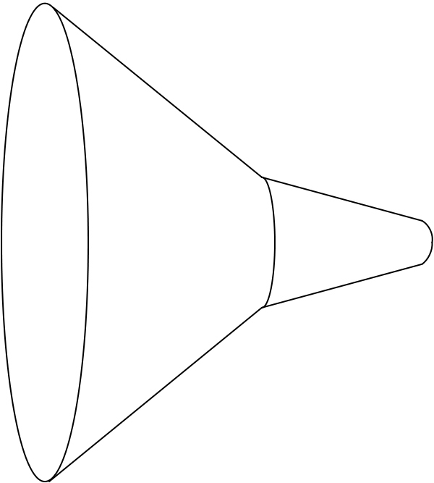
curatedMetagenomicData pipeline
Raw
fastq files
26 datasets
> 6,000 samples
Study metadata
Age, body site, disease, etc…
Differential abundance
Diversity metrics
Clustering
Machine learning
Convenience download functions
Megabytes-sized datasets
Download (~100TB)
ExperimentHub product
Amazon S3 cloud distribution
Tag-based searching
Dataset snapshot dates
Automatic local caching
Uniform processing
Manual curation
MetaPhlAn2
HUMAnN2
Automatic documentation
species abundance
metabolic pathway abundance
Integrated Bioconductor ExpressionSet objects
Per-patient microbiome data
Per-patient metadata
Experiment-wide metadata
marker
presence
metabolic pathway presence
standardized metadata
marker abundance
gene family abundance
Integration
Offline high computational load pipeline
> 120 kH CPU
https://waldronlab.github.io/curatedMetagenomicData/
Notes:
https://upload.wikimedia.org/wikipedia/commons/thumb/7/7e/Funnel_Mech.svg/667px-Funnel_Mech.svg.png
https://pixabay.com/en/cheering-happy-jumping-people-297419/

Slide 13
Link to tonight’s workshop
www.github.com/waldronlab/MicrobiomeWorkshop

